Slide 1

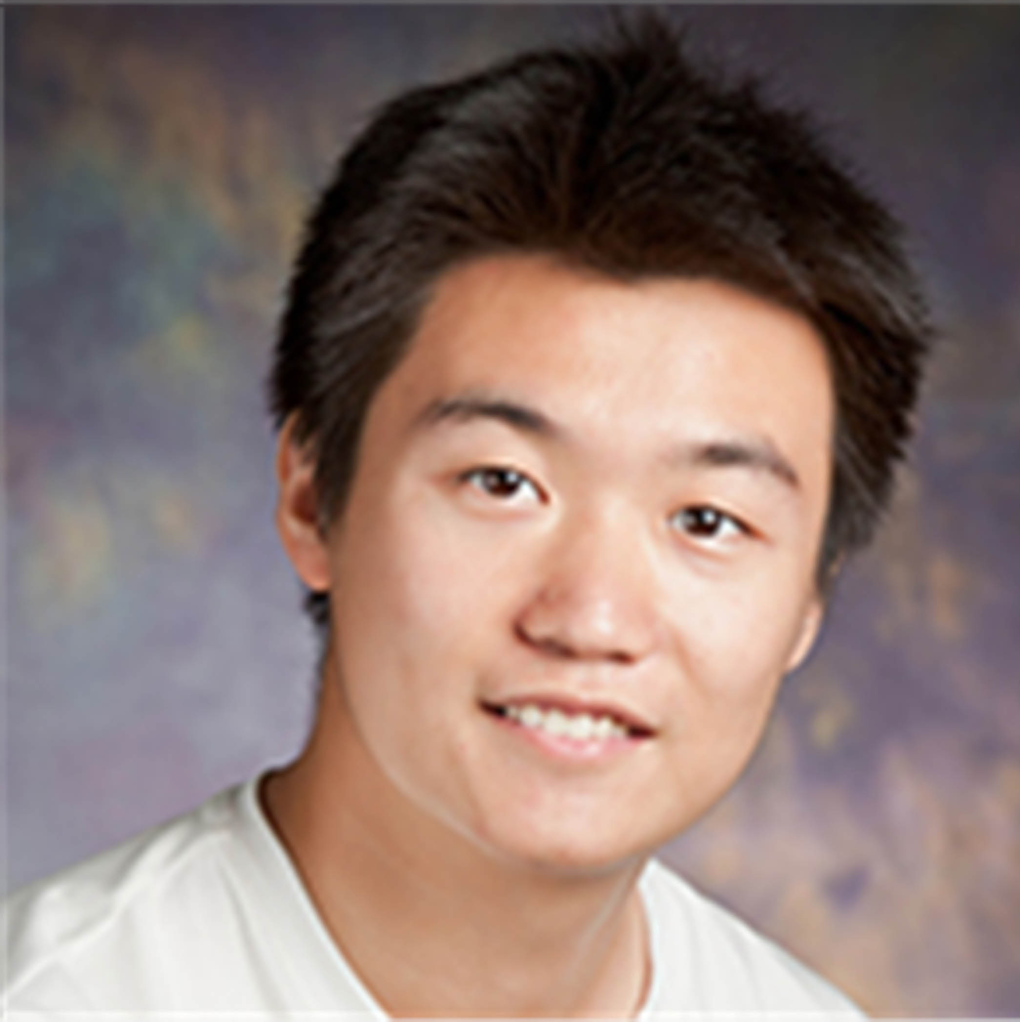

Temporal Common Sense Acquisition with Minimal Supervision
Ben Zhou Qiang Ning* Daniel Khashabi* Dan Roth
*
Notes:
Welcome to our work titled …… This is done with my co-authors Qiang Ning and Daniel Khashabi who are now at AI2, and my advisor Dan Roth.

Slide 2
Time and Common Sense
Choose from “will” or “will not”
Dr. Porter is taking a vacation and ___ be able to see you soon.
Dr. Porter is taking a walk and ___ be able to see you soon.
Notes:
Let me start with an example, where the task is to fill the blanks with either “will” or “will not”.

Slide 3
Time and Common Sense
Choose from “will” or “will not”
Days
Dr. Porter is taking a vacation and ___ be able to see you soon.
Dr. Porter is taking a walk and ___ be able to see you soon.
Notes:
In the first case, we know Dr. Porter taking a vacation is likely to last days to weeks

Slide 4
Time and Common Sense
Choose from “will” or “will not”
Days
Dr. Porter is taking a vacation and will not be able to see you soon.
Dr. Porter is taking a walk and ___ be able to see you soon.
Notes:
, so she will not be able to see patients soon.

Slide 5
Time and Common Sense
Choose from “will” or “will not”
Days
Minutes
Dr. Porter is taking a vacation and will not be able to see you soon.
Dr. Porter is taking a walk and ___ be able to see you soon.
Notes:
However, in the second case, taking a walk usually last minutes to hours

Slide 6
Time and Common Sense
Time:
An important component for reading comprehension
Commonsense-level understanding is required
Choose from “will” or “will not”
Days
Minutes
Dr. Porter is taking a vacation and will not be able to see you soon.
Dr. Porter is taking a walk and will be able to see you soon.
Notes:
, so she is likely to be back soon and see the patient. Hopefully this small example is able to convince you that time is an important component for reading comprehension, and a commonsense-level of understanding is required.

Slide 7
This work
Time
An important component for reading comprehension
Commonsense-level understanding is required
In this work
TacoLM – A general LM that is aware of time and temporal common sense
Minimal Supervision
confidence
Notes:
In this work, we propose TacoLM, a general language model that is aware of time and temporal common sense, and at the same time built without any annotations. We show that our model is better at solving time-related tasks. For example, in this actual prediction of duration from our model,

Slide 8
Time and Common Sense
Time
An important component for reading comprehension
Commonsense-level understanding is required
In this work
TacoLM – A general LM that is aware of time and temporal common sense
Minimal Supervision
Dr. Porter is coming back shortly.
confidence
Notes:
We see that Dr. Porter taking a walk is a short event lasting from minutes to hours

Slide 9
Time and Common Sense
Time
An important component for reading comprehension
Commonsense-level understanding is required
In this work
TacoLM – A general LM that is aware of time and temporal common sense
Minimal Supervision
Dr. Porter is coming back shortly.
She may not be back for days.
confidence
Notes:
While taking a vacation is much longer, ranging from days to even months. This information helps with solving the previous example problem.

Slide 10
Acquiring Temporal Common Sense
Challenging
Reporting Biases:
people rarely mention the common sense to be efficient “It took me 2 seconds to move my chair”
Sometimes highlight rarities “It took me an hour to move my chair”
Highly Contextual:
The duration of “Move” depends on the object’s weight/size.
confidence
Notes:
♦There are several reasons why building a time-aware model with minimal supervision is challenging. ♦First, there are reporting biases. That is, ♦people rarely mention the temporal commonsense information to be efficient in written language, so it’s rare to observe phrases like “it took me 2 seconds to move my chair”. ♦However, people sometimes highlight the rarities, so we may see sentences like “it took me an hour to move my chair”. This confuses a model that tries to learn or acquire such information from unannotated natural text.
♦This task is also highly contextual, as we want our model to attend to fine grained contexts. ♦For example, it is meaningless to predict the duration of “move”, as we will need to at least know more about the object, and the duration of move depends on the object’s weight or size, or even more.
♦Our proposed TacoLM is able to address reporting biases to some level and attends to the context. As shown here, TacoLM correctly predicts that moving a chair takes only seonds while moving a piano takes much longer, averaging hours.

Slide 11
Time and Common Sense
Time
An important component for reading comprehension
Temporal order
Event duration / frequency
Typical events and their occurring time
…
Explicit textual cues (before, after, at the same time) are rare
Commonsense-level understanding is required
Example: Choose from “will” or “will not”
Dr. Porter is taking a vacation and ____ be able to see you soon.
Dr. Porter is taking a walk and _____ be able to see you soon.

Slide 12
Time and Common Sense
Time
An important component for reading comprehension
Temporal order
Event duration / frequency
Typical events and their occurring time
…
Explicit textual cues (before, after, at the same time) are rare
Commonsense-level understanding is required
Example: Choose from “will” or “will not”
Dr. Porter is taking a vacation and will not be able to see you soon.
Dr. Porter is taking a walk and will be able to see you soon.

Slide 13
Temporal Common Sense
This work: acquire temporal commonsense knowledge
Duration, Frequency, Typical time
Minimal Supervision
It is challenging:
Highly contextual
Hard to understand event arguments’ relation to its duration/frequency
Duration: I move a chair < I move a piano (weight)
Duration: I build a chair < I build a piano (complexity)
Reporting Biases
Rare to see people describing how long they brushed their teeth
Our view: model distributions of temporal properties of events in fine grained contexts

Slide 14
This Work
TacoLM
a general time-aware language model that distincts temporal properties in fine grained contexts.

Slide 15
This Work
Example: Choose from “will” or “will not”
Dr. Porter is taking a vacation and will not be able to see you soon.
Dr. Porter is taking a walk and will be able to see you soon.

Slide 16
TacoLM – the Big Picture
Goal: build a general time-aware LM with minimal supervision
Use high-precision patterns to acquire temporal information
Unsupervised automatic extraction
Overcomes reporting biases with a large amount of natural text
Multiple temporal dimensions
Duration ~ 1 / Frequency
Further generalization to combat reporting biases
Step 1: Information Extraction
Step 2: Joint Language Model Pre-training
“I brush my teeth every morning”
Duration of “brushing teeth” < morning
Output: TacoLM- a time-aware general BERT
Notes:
♦With the goal of building a general time-aware LM with minimal supervision, ♦we start with a focused, unsupervised information extraction step, ♦in which we use a set of high-precision patterns to acquire temporal information. ♦This helps the model to overcome reporting biases as we can automatically extract over a large amount of natural text.
♦We use the temporal information acquired in step 1 in the second step called joint language model pretraining. ♦That is, we pre-train our language model jointly over multiple temporal dimensions, ♦so that it is able to utilize the natural relations such as duration being inversely related to frequency. ♦This is beneficial. For example, we may not see direct mentions of the duration of brushing teeth, however, we know that it is shorter than a morning as the frequency is likely to be every morning. ♦This provides further generalization to combat reporting biases.
♦Finally, we obtain our final model TacoLM, a BERT transformer that is more aware of time.

Slide 17
Step 1: Information Extraction
Step 1: Information Extraction
Step 2: Joint Language Model Pre-training
Output: TacoLM- a time-aware general BERT
Notes:
Let me elaborate each step starting from the information extraction.

Slide 18
Joint learning from free text
In general: we trained a BERT that is aware of time in a more unbiased way
Pattern Extraction:
Unsupervised
Multiple Dimensions (duration, frequency, auxiliaries…)
Natural constraints: duration <= 1/frequency
Joint Pretraining
Use soft cross entropy that assumes a bell-shaped distribution across values
Also allows for circular relationships like day of weeks
Use full event masking and label adjustment to combat reporting biases further
General LM: with the off-the shelf capability of predicting temporal properties
Pattern Extraction
Joint Pretraining
General LM

Slide 19
Information Extraction
Use high-precision patterns based on SRL
Duration
Frequency
Typical Time
Duration Upperbound
Hierarchy
Labels
Units (seconds, … centuries)
Temporal keywords (Monday, January, …)
Output
4.3M instances of
(event, dimension, value) tuple
I played basketball for 2 hours.
Original sentence
SRL Parse
Arg-0
Arg-1
I played basketball for 2 hours.
Verb
Arg-Tmp
Pattern Matching
for 2 hours: matches Duration pattern
Event
Value
I played basketball, Duration, Hours
Formatted Output Instance
Dimension
Notes:
♦In this step, we use a set of high-precision patterns based on SRL parsing to mine temporal information in ♦ duration, frequency and typical time. ♦We also acquire information on two auxiliary dimensions that may not be useful by themselves but are related to our three main temporal dimensions above.
♦Consider a raw sentence I played basketball for two hours as an example. ♦We first apply a SRL model and get the verb and arguments. In this case, there is a temporal argument for 2 hours, ♦which further matches one of our patterns for duration. That is, we know that for 2 hours is describing the duration of the verb played. ♦Following this, we are able to format it into a training instance of a event, dimension and value tuple.
♦We use the units, namely seconds, minutes, all the way to centuries as the labels for duration and frequency. ♦For typical time, we use the temporal keywords such as Monday and January as the labels. ♦The output contains 4.3M (event, dimension, value) tuples for pre-training.

Slide 20
Step 2: Language Model Pre-training
Step 1: Information Extraction
Step 2: Joint Language Model Pre-training
Output: TacoLM- a time-aware general BERT
Notes:
We use the data from Step 1 in the next step as supervision signals.

Slide 21
Sequence Classification
Consider [Event] [Dimension] [Value] tuples in each instance
[E1, E2, … M, ET … En, SEP, M, Dim, Val]
M is a special marker, same across all dimension/value
Dim is a marker for each dimension, Val is a marker for the value of the dimension
With an example:
I played basketball for 2 hours.
Information Extraction
I played basketball, Duration, Hours
Sequence Formatting
I [M] played basketball [SEP] [M] [DUR] [HRS]
Notes:
♦Specifically, for each event, dimension and value tuple, ♦we format it into a sequence of tokens, in which we use special markers to mark the location of the verb, in order to represent the event, and place special tokens that represent the temporal dimension and the value in the same sequence.
♦♦Consider the same example I played basketball for 2 hours. ♦♦We extracted a training instance from the information extraction step, ♦♦and we now further format it into a single sequence containing all the information.

Slide 22
Joint Model with Masked LM
I [M] played basketball [SEP] [M] [DUR] [HRS]
Baseline Model: Pre-trained BERT-base
Main objective: mask some tokens and recover them
How we mask:
With some probability, mask temporal value while keeping others
Otherwise, mask a certain portion of E1...En while keeping temporal value unchanged
Max (P(Event|Dim,Val) + P(Val|Event,Dim)); Preserving original LM capability
Benefits:
Jointly learn one transformer towards all dimensions
Labels play a role in the transformer
One event may contain more than one (Dim + Val), so the model learns dimension relationships
I [M] played basketball [SEP] [M] [DUR] [MASK]
I [M] [MASK] [MASK] [SEP] [M] [DUR] [HRS]
Notes:
♦We build our model on top of the pre-trained BERT-base model and ♦employ a simple objective of masking some tokens in our formatted sequence and then recover them. ♦♦♦With the higher probability, we mask the temporal value while keeping the others. ♦♦Otherwise, We will instead mask some event tokens and keep the temporal value token unchanged. ♦In this case, we can maximize the conditional probability of the events and the value at the same time to preserve the original capability of a language model.
♦The benefits of formatting sequences and use the masked LM objective are that we can jointly learn one transformer towards all dimensions, including the original language model capability, ♦and labels play a role in the transformer architecture. ♦As one event may contain more than one (Dim + Val) pair, the model is able to learn inter-dimension relationships.

Slide 23
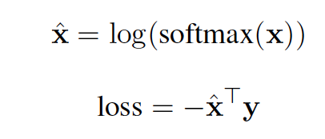
Joint Model with Masked LM
I [M] played basketball [SEP] [M] [DUR] [HRS]
1: Soft cross entropy for recovering Val
If gold label is “hours”, the label vector y for “minutes, hours, days” will be [0.16, 0.47, 0.25]
2: Label weight adjustment
Instances with “seconds” have higher loss than those with “years”
3: Full event masking
Instead of 15% used by BERT, we use 60% when masking E1, … En to reduce biases
I [M] had a cup of [MASK] [SEP] [M] [TYP] [Evening]
-> MASK = coffee, because “cup of”
I [M] had [MASK] [MASK] of [MASK] [SEP] [M] [TYP] [Evening]
Notes:
♦We also use additional techniques including a soft cross entropy loss for temporal value recovery. ♦♦For example, if the gold label is hours, the neighboring values minutes and days will have a non-zero target value. ♦We use label weight adjustments to address the label imbalance in the training data.
♦We also use an additional technique called full event masking to further reduce biases, where instead of the 15% used by BERT, we use 60% when masking the event tokens.
♦This is helpful because a model may attend too much on strong priors, for example, ♦BERT will always predict “coffee” to follow “a cup of”, no matter what the temporal argument is. ♦However, if we mask the phrase “a cup of”, the prediction of the drink will be more conditioned to the temporal value, so that we may see some drink other than coffee to be the most popular choice in evenings.

Slide 24
Evaluation
Step 1: Information Extraction
Step 2: Joint Language Model Pre-training
Output: TacoLM- a time-aware general BERT
Notes:
Now that we have our model TacoLM, it’s time to evaluate its performances.

Slide 25
Evaluation: Intrinsic (Embedding space)
A collection of events with duration of “seconds,” “weeks” or “centuries” (three extremes)
BERT (left), Ours (right) representation on the event’s trigger
PCA + t-SNE to 2D visualization
Our model separates the events much better (➔ our model is aware of time)
BERT
TacoLM
Notes:
We start by looking at the embedding space comparison between BERT and TacoLM. The visualization is done over a set of events with durations of seconds, weeks, or centuries. ♦The left visualization is from BERT, ♦while the one on the right is from TacoLM, where events are better clustered by their durations.

Slide 26
Evaluation: Intrinsic (Quantitatively)
Metric: Distance to gold label
Dist (seconds, hours)=2, Dist (minutes, hours)=1
Lower the better
RealNews [Zellers et al. 2019]: no document overlap
Raw corpus + MTurk annotation
UDS-T [Vashishtha et al. 2019]: duration only
19% average improvement
Notes:
We also conduct quantitative intrinsic evaluations where the task is to directly predict events’ temporal dimensions including duration, frequency and typical time. ♦♦We use a metric called distance to gold which is lower the better. ♦For the data. we annotated some instances based on raw texts from RealNews so that there is no document overlap with our pre-training data. ♦We see that our model is able to produce ♦an average improvement of 19% over the baseline model BERT.
♦We also evaluate on UDS-T, a duration only annotation benchmark, ♦on which our proposed TacoLM is also able to improve.

Slide 27
Evaluation: Extrinsic (TimeBank)
Task: Identify if an event’s duration is longer than a day or shorter
Model (finetuned):
Demonstrate the model as a general purpose LM
Pre-trained duration prediction layer is not used
Results

Slide 28
Evaluation: Extrinsic
Use as a general language model with finetuning
Task: Identify event-event hierarchical relations
HiEVE [Glavas et al. 2014]
Child-Parent / Parent-Child / Coreference
A bomb exploded. This is the sixth accident since the war started.
Model (finetuned):
Sentence pair classification
Results (F1, higher the better)
war
accident
=
exploded
More Intrinsic/Extrinsic experiments in the paper!
Notes:
♦To show that our model is indeed a general language model, we also evaluate on extrinsic tasks with finetuning on task-specific training data. ♦♦One task we selected is to identify inter-event relations ♦including child-parent, parent-child and coreference. ♦♦For example, accident and explosion are coreferencing each other in this example sentence, and they are both child events of war.
♦We use BERT’s sequence pair classification model and apply the same training process with the only difference being the internal weights of the transformer. ♦♦In this task, we see that TacoLM is able to improve around 8% on child-parent, parent-child relations.
♦There are more experiments in our paper, please read it for other comparisons.

Slide 29
Evaluation: Extrinsic (MC-TACO)
Task: QA on temporal related questions. (how long, how often, etc.)
Model (finetuned)
Standard BERT QA model
Results

Slide 30
Conclusion - TacoLM
Thank you!
Code & Data: https://github.com/CogComp/TacoLM
Time-aware with minimal supervision
Joint pre-training over multiple temporal dimensions
Able to directly predict events’ duration, frequency or typical time
19% better on direct prediction tasks
Bell-shaped predictive distributions
Differentiates fine grained event contexts
Works as a general language model
8% improvement on child-parent event relation extraction
I played basketball for 2 hours
Frequency of “brushing teeth” = every morning”
Duration of “brushing teeth” < morning
Notes:
In conclusion, ♦we build a time-aware language model, and we are able to do this without annotations thanks to the ♦unsupervised information extraction step based on patterns. ♦We propose a joint learning scheme ♦that is able to utilize the inter-dimension relations. ♦The final model is able to directly predict events’ duration, frequency and typical time, ♦with an average 19% improvement over BERT. ♦It also produces bell-shaped distributions over continuous labels, ♦♦ and it differentiates fine grained contexts.
♦It also works as a general language mode, achieving 8% improvement on child-parent event relation extraction tasks. ♦Please refer to this link for our model and data, thank you!

